Slide 1

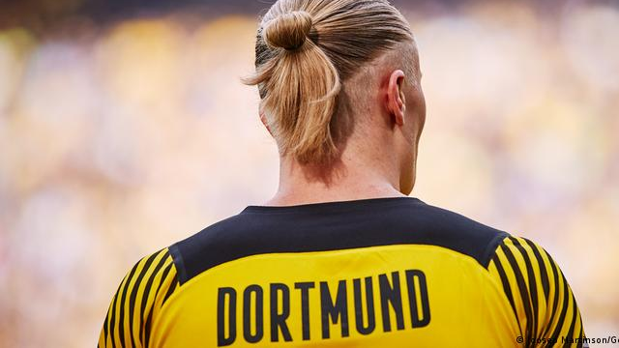
Haaland Replacement Project

Slide 2
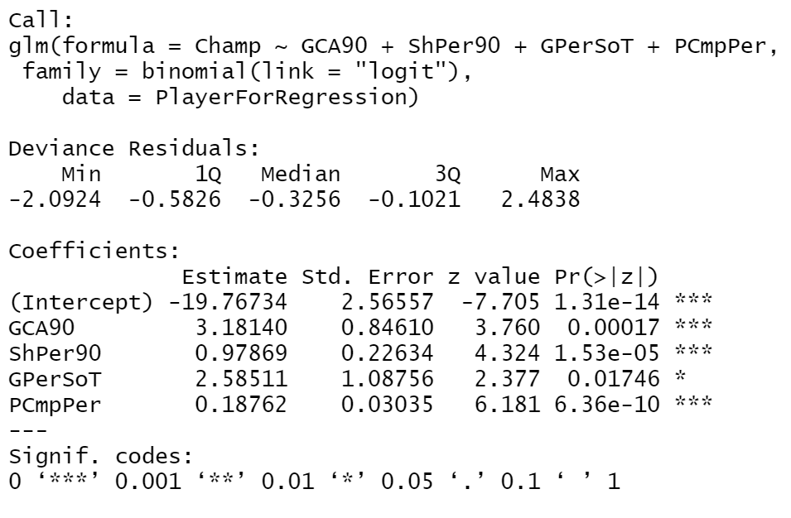
RELEVANT VARIABLES OF PLAYERS THAT INFLUENCE THE PERFORMANCE OF TEAMS

Slide 3
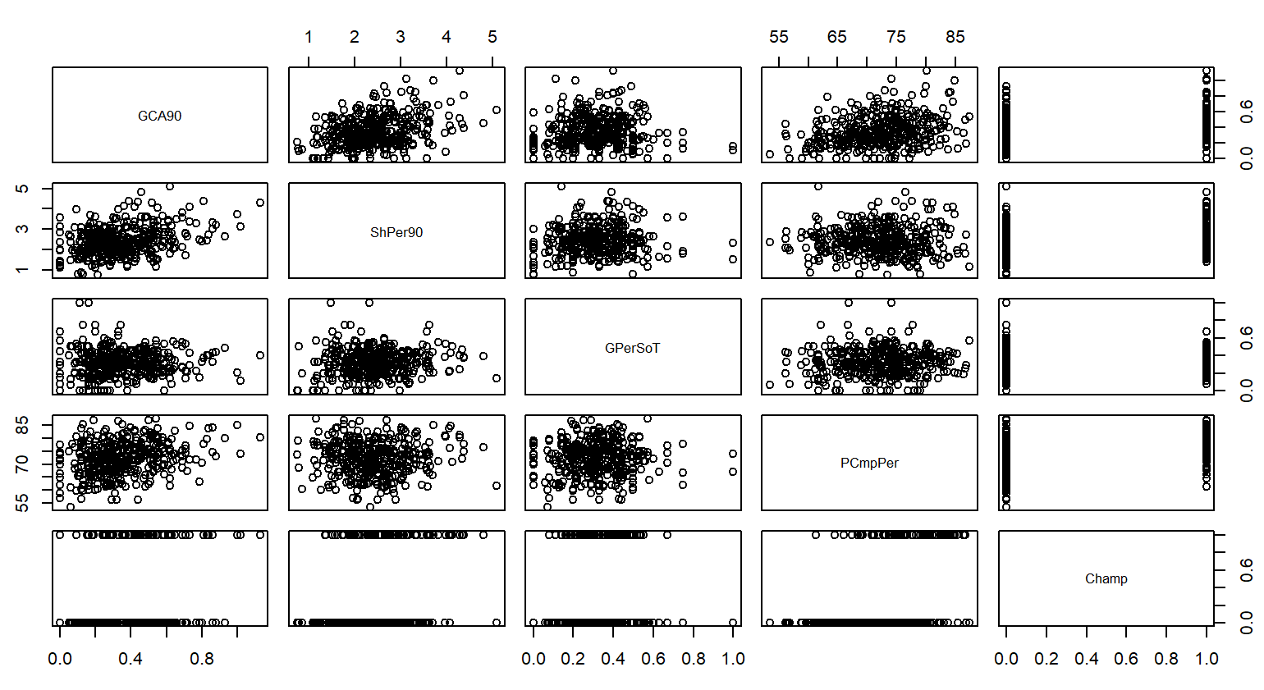
Scatterplot

Slide 4
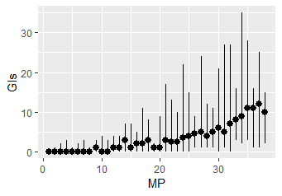
Goals Analysis

Slide 5
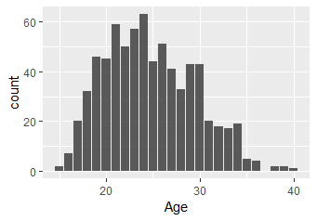
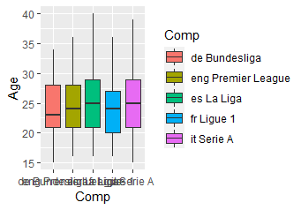
Age Analysis

Slide 6
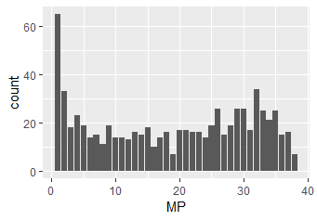
Matches Played Analysis

Slide 7

Relevant Variables to Compare Relevant Players

Slide 8
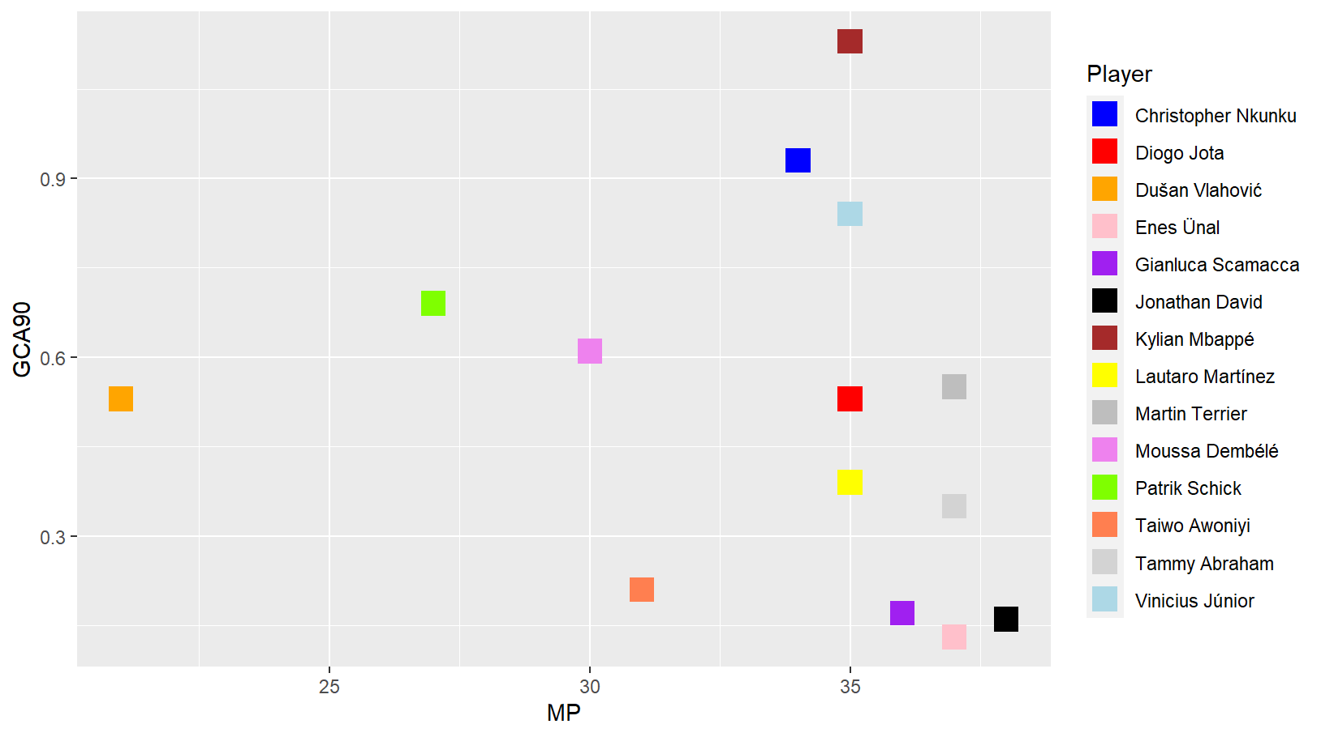
1 - Goal Creation Action per 90’

Slide 9
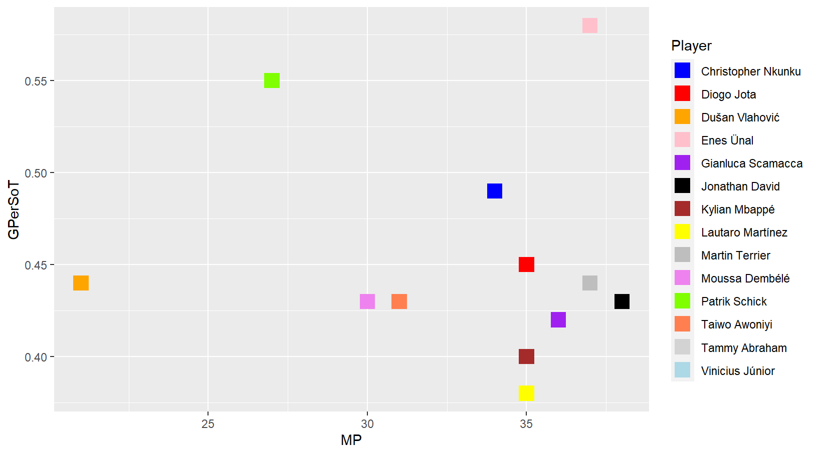
2 - Goal Per Shot On Target

Slide 10
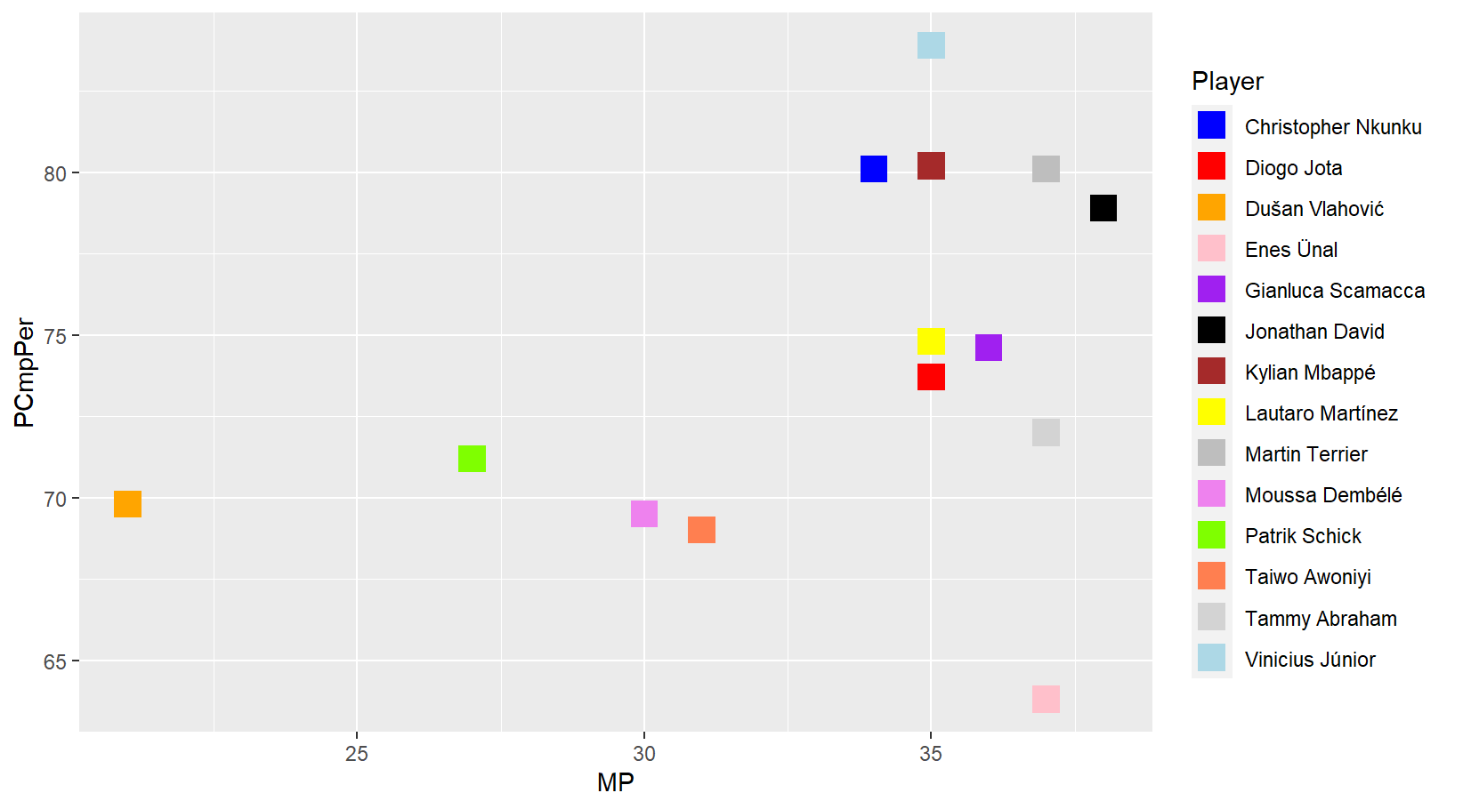
3 - Percentage of Passes Completed

Slide 11
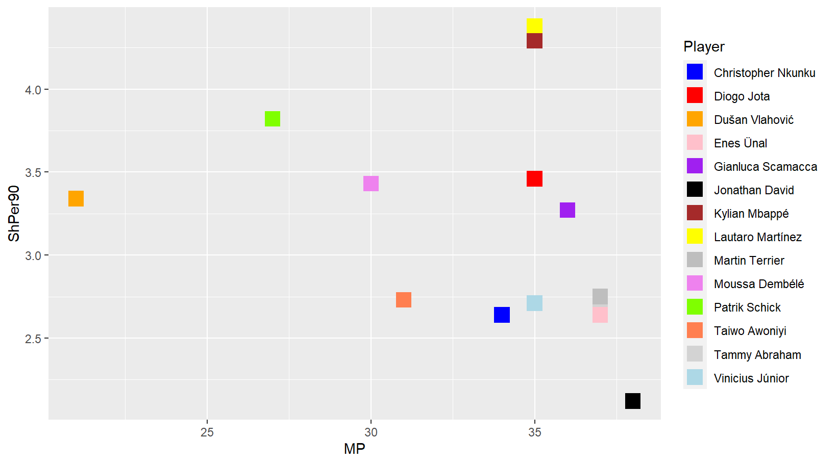
4 - Shot Per 90’

Slide 12
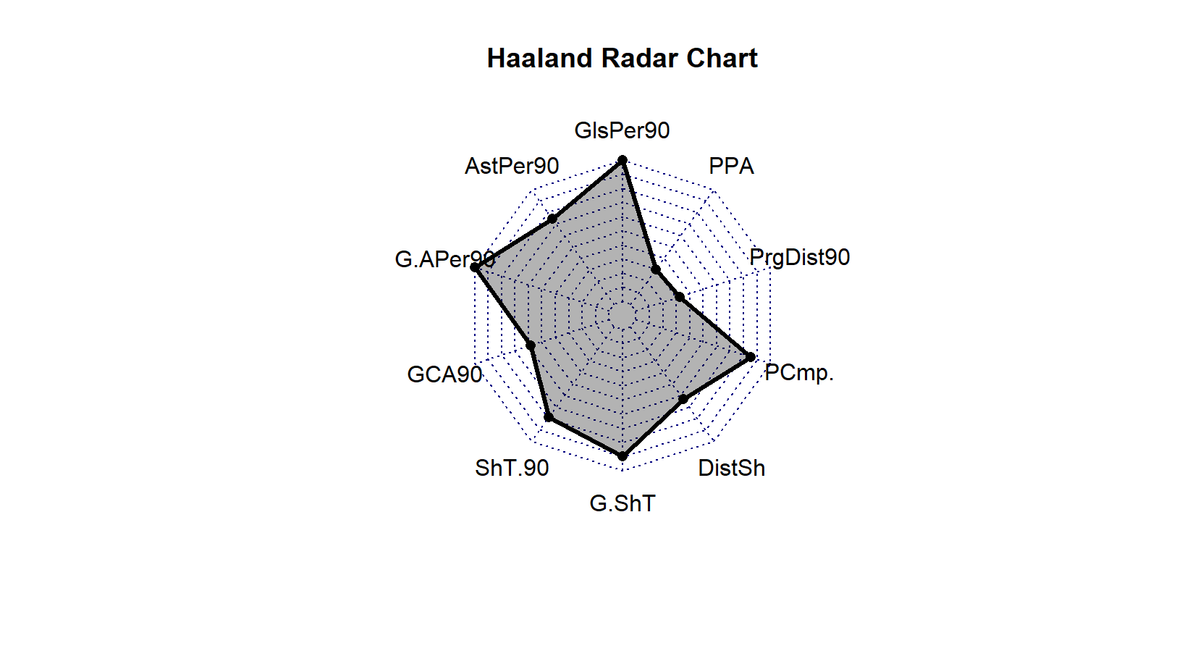
Haaland Radar Chart

Slide 13
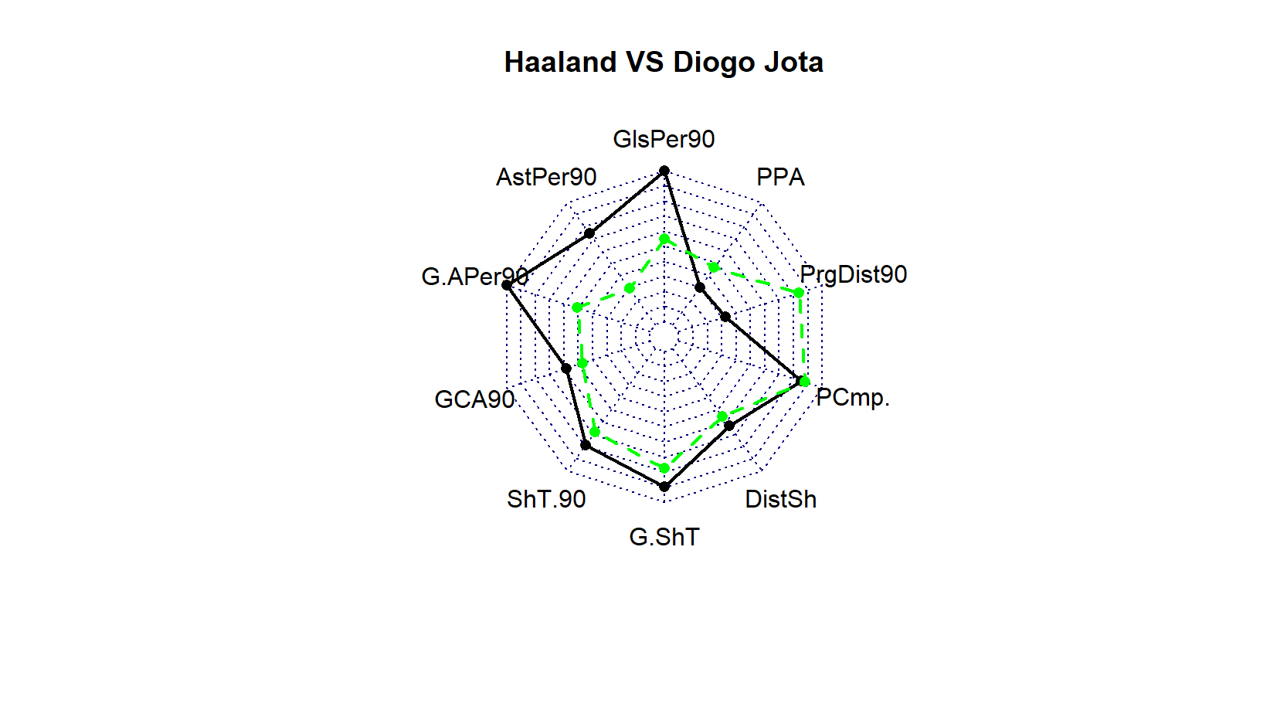
Players To Compare Diogo Jota

Slide 14
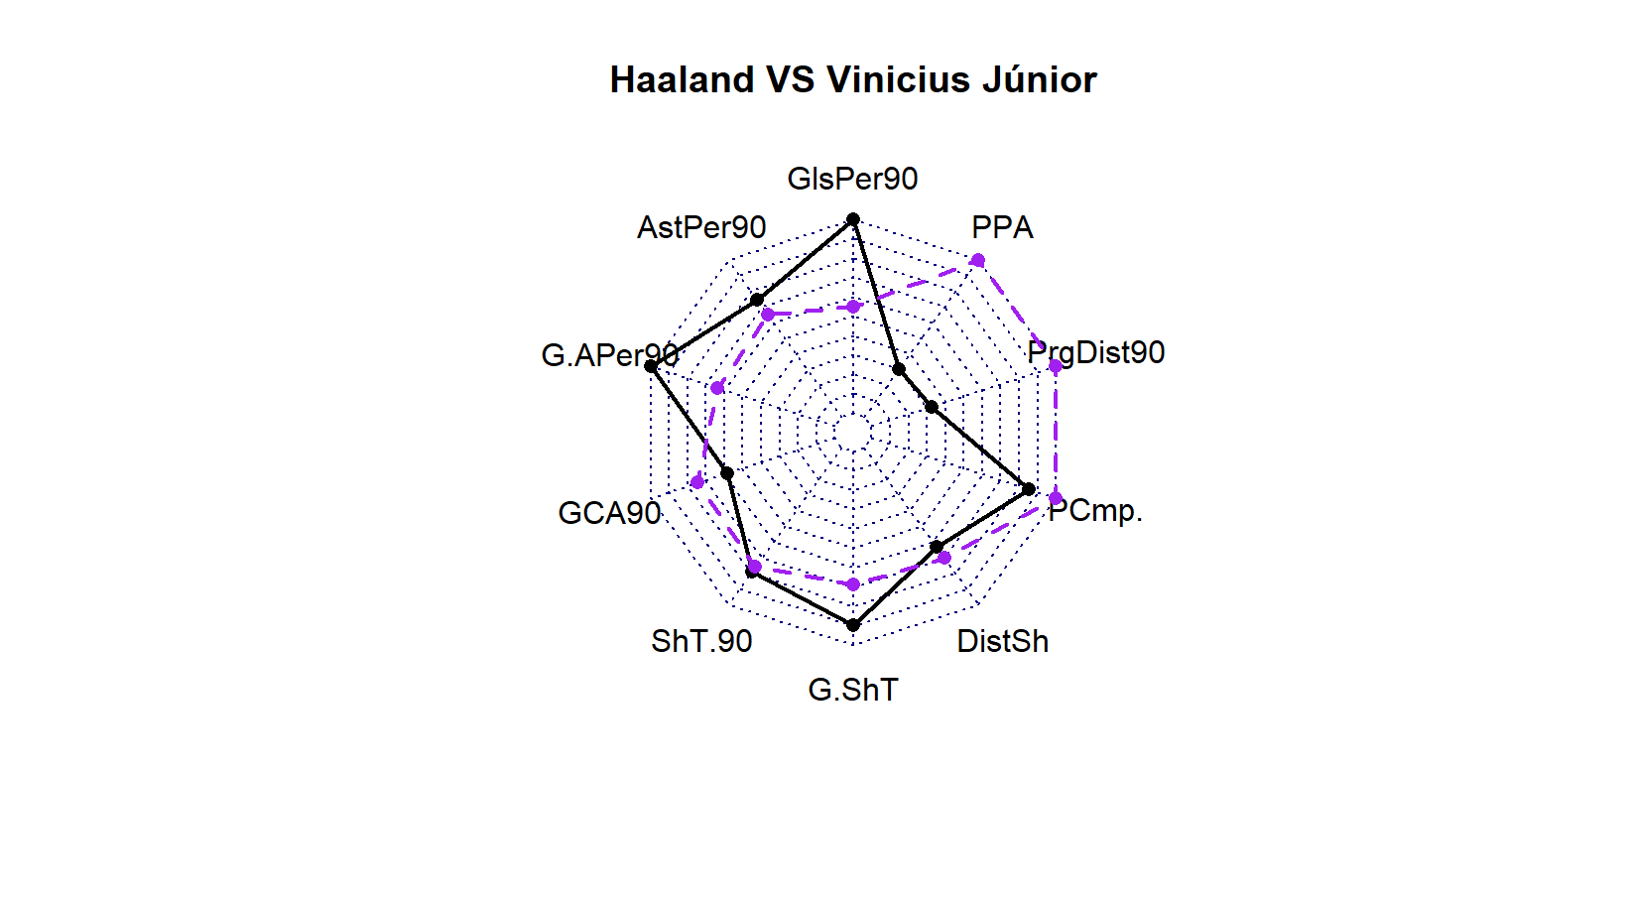
Players To Compare Vinicius Juniors

Slide 15
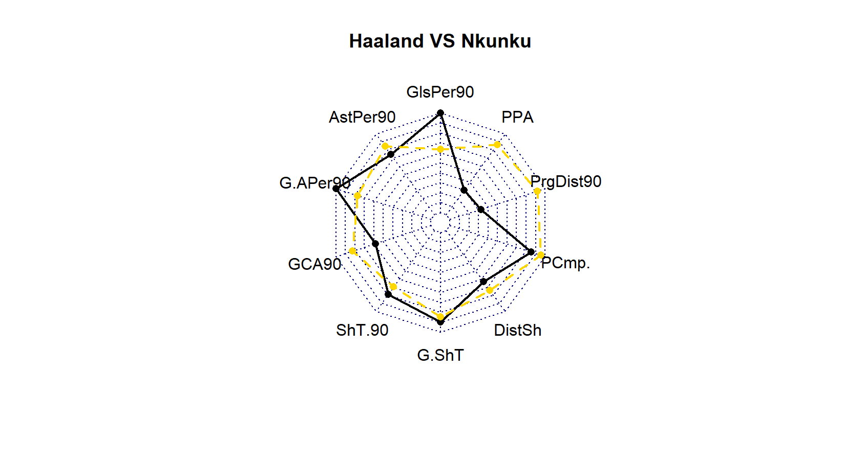
Players To Compare Nkunku

Slide 16
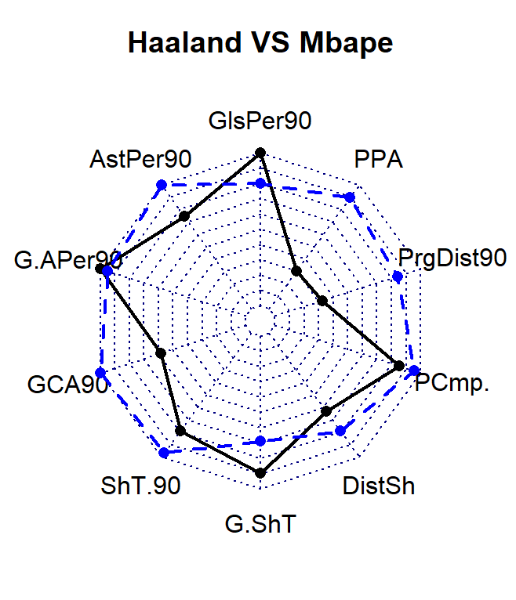
Players To Compare Mbappe

Slide 17
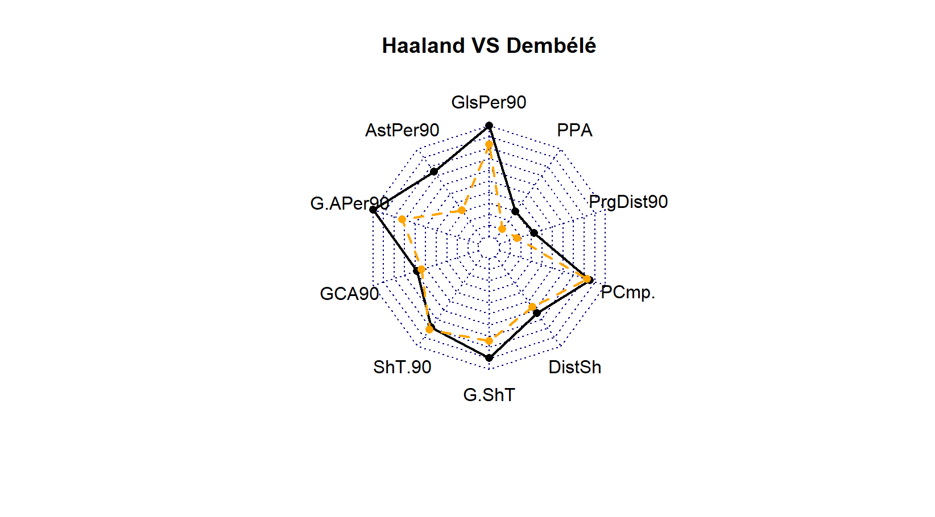
Players To Compare Dembele

Slide 18
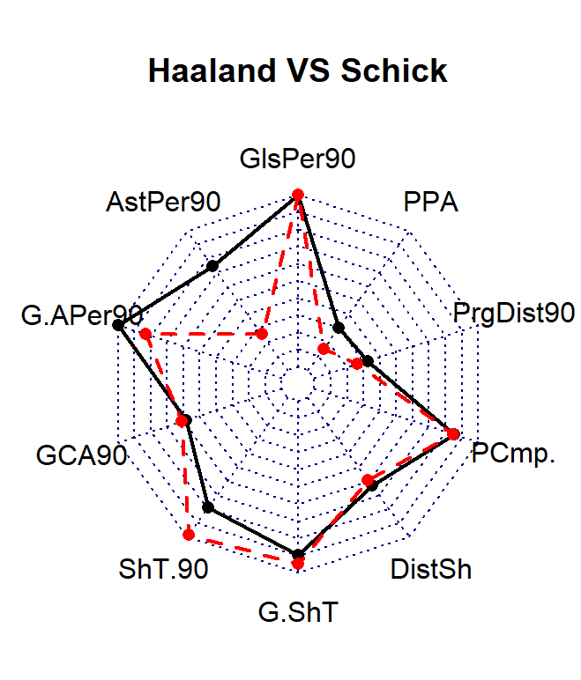
Players To Compare Schick

